Slide 1

Walmart
Customer Segmentation Analysis

Slide 2
Agenda
Company Overview​
History
Vision & Mission
Goals
Marketing Mix
STP analysis
Marketing strategies
Marketing strategy of competitors
SWOT analysis
Insights & Recommendations
Recommendations
Reference

Slide 3
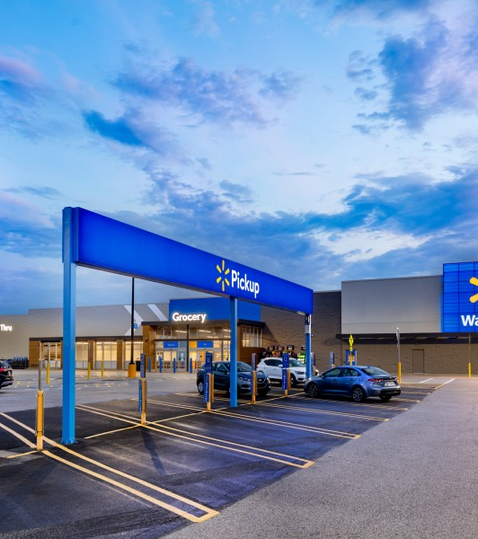
Company Overview
Founded: July 2, 1962, Rogers, Arkansas, USA
Founders: Sam Walton, Bud Walton
Headquarters: Bentonville, Arkansas, USA
Locations: 10,586 stores worldwide (2022)
Revenue: $648.12 billion (FY2024)
Employees: 2.1 million (2024)
Industry: Retail

Slide 4
History of Walmart
1962: Walmart was founded by Sam Walton and Bud Walton in Rogers, Arkansas, as "Wal-Mart Discount City.“
1969: Incorporated as "Wal-Mart, Inc.“
1970: Became "Wal-Mart Stores, Inc."; went public and was listed on the New York Stock Exchange.
1980s: Expanded nationally, becoming the largest retailer in the USA by 1990..
1991: Began international expansion with stores in Mexico.
2000: Entered e-commerce with Walmart.com.
2018: Renamed "Walmart Inc." to reflect its evolution into a global omnichannel retailer.
Present: Operates globally, with divisions including Walmart U.S., Walmart International, Sam’s Club, and Global eCommerce.

Slide 5
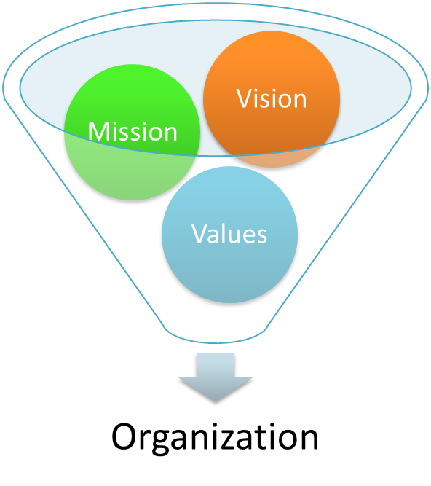
Vision & Mission
Vision Statement:
“To be the destination for customers to save money, no matter how they want to shop.”
Walmart envisions providing affordable products to customers across all channels—physical stores, online, and mobile.
Mission Statement:
“To save people money so they can live better.”
Walmart's mission reflects its commitment to offering low prices and improving the quality of life for its customers.
This Photo by Unknown Author is licensed under CC BY

Slide 6
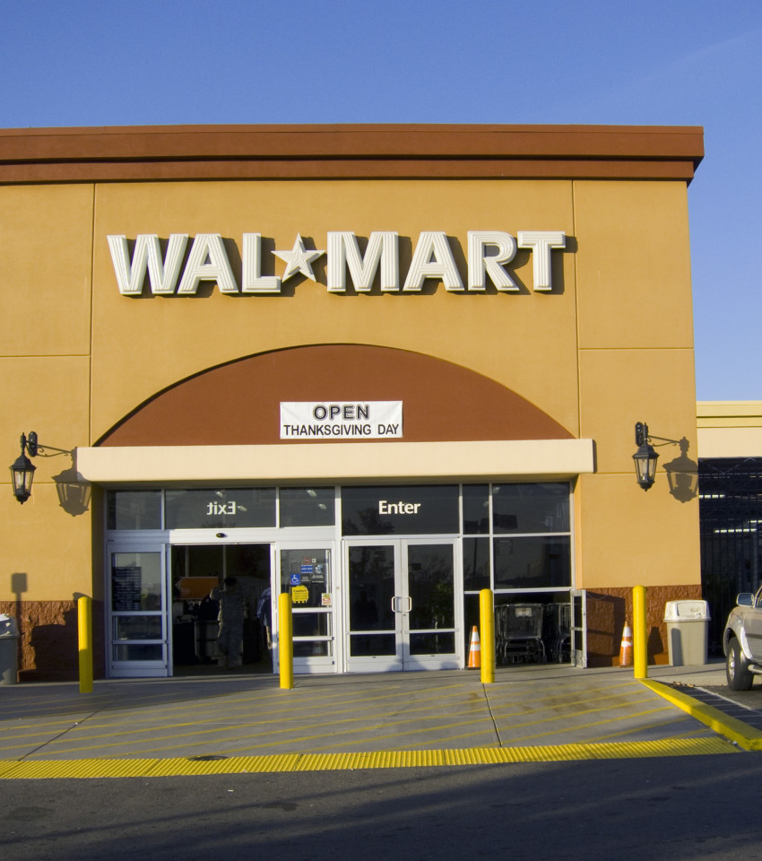
Goals of Walmart
Goals:
Customer-Centric Growth: Expand its global presence while enhancing customer experiences through omnichannel retailing.
Sustainability: Reduce its environmental footprint by adopting renewable energy and sustainable sourcing practices.
Technological Innovation: Leverage advanced technologies like AI and automation to improve supply chain efficiency and personalization.
Community Support: Strengthen local economies by providing jobs and supporting charitable initiatives.
Employee Growth: Offer training, education programs, and competitive pay to empower its workforce.

Slide 7
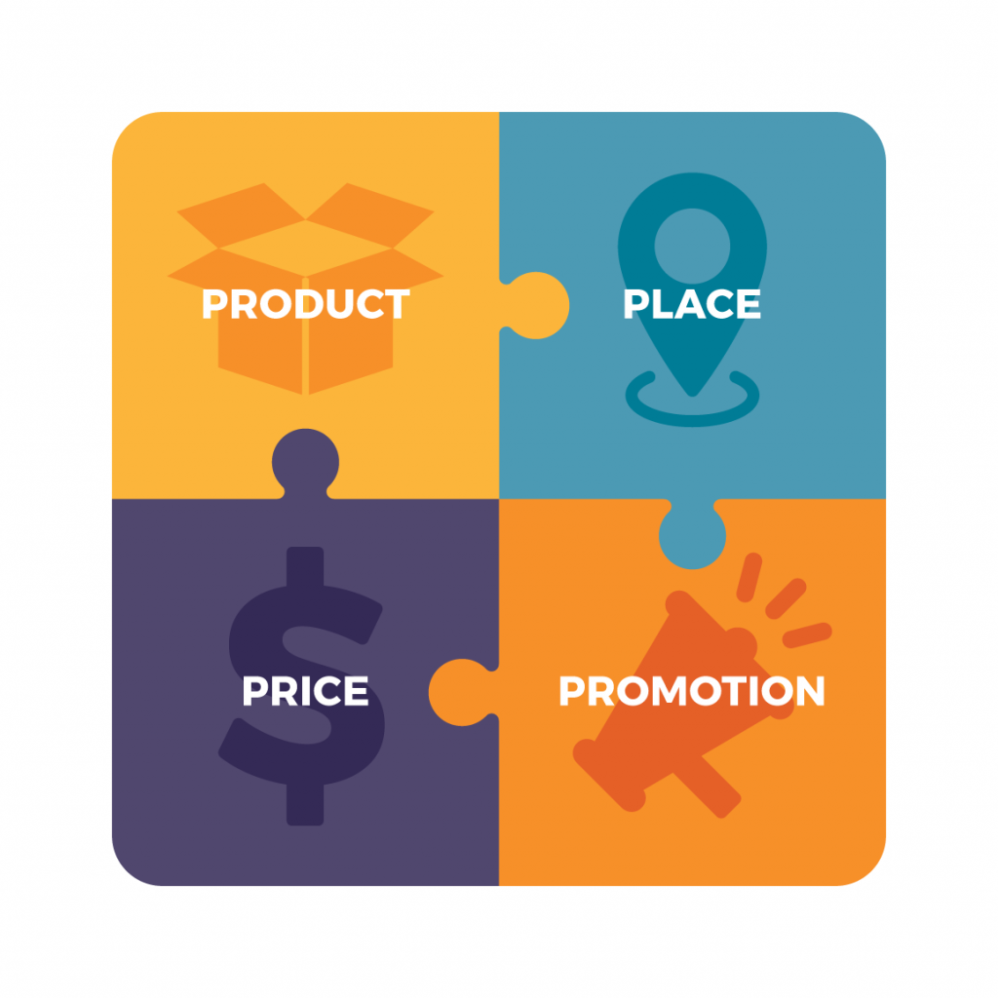
Marketing Mix (4 Ps)
1. Product
Extensive Assortment: Offers a wide range of products, including groceries, electronics, apparel, and furniture, providing convenience for customers.
Private Label Brands: Promotes brands like Great Value and Equate for quality and affordability, ensuring differentiation and higher profit margins.
Exclusive Partnerships: Collaborates with brands and celebrities for exclusive product lines, driving customer interest.
Sustainability: Focuses on eco-friendly products to meet consumer demand for sustainability.
2. Price
Everyday Low Prices (EDLP): Core strategy leveraging purchasing power and supply chain efficiency.
Rollbacks and Promotions: Temporary price reductions to encourage immediate purchases.
Price Matching: Ensures customer confidence by matching competitor prices.
4
This Photo by Unknown Author is licensed under CC BY-SA-NC

Slide 8
Marketing Mix (4 Ps)
3. Place
Strategic Store Locations: Targets suburban and semi-rural areas for easy accessibility.
Omnichannel Presence: Seamless integration of physical stores and online platforms like Walmart.com.
Efficient Distribution Network: Optimizes product availability through strategically located distribution centers.
4. Promotion
Advertising: Utilizes TV, radio, print, and digital platforms for widespread reach.
In-Store Promotions: Employs attractive displays and signage to drive impulse purchases.
Digital Marketing: Leverages social media, email campaigns, and targeted ads for customer engagement.
Loyalty Programs: Offers Walmart+ benefits, including free shipping and exclusive discounts, fostering customer loyalty.
4
This Photo by Unknown Author is licensed under CC BY-SA-NC

Slide 9
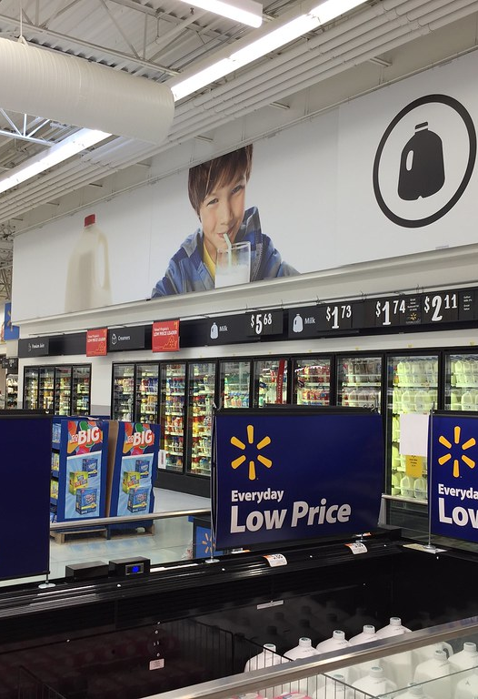
STP Analysis
Walmart leverages the STP model to cater to its diverse customer base by segmenting markets, targeting value-conscious shoppers, and positioning itself as a one-stop retailer offering "Everyday Low Prices," ensuring alignment with customer needs and market competitiveness.
Segmentation
Demographic: Caters to diverse age groups, including millennials, families, and seniors, with a focus on middle- and low-income shoppers.
Geographic: Operates globally with a strategic presence in urban, suburban, and semi-rural areas to reach a broad audience.
Psychographic: Targets budget-conscious families with affordable, practical products and young shoppers with trendy offerings.
Behavioral: Analyzes purchasing patterns to offer tailored promotions, discounts, and targeted campaigns.
This Photo by Unknown Author is licensed under CC BY

Slide 10
STP Analysis
Targeting
Value-Conscious Shoppers: Appeals to those seeking affordability and competitive prices.
Families: Provides a wide variety of family-oriented products, including groceries and household essentials.
Tech-Savvy Shoppers: Offers robust e-commerce platforms with delivery and pickup options.
Urban and Suburban Consumers: Ensures accessibility through strategic store locations.
Positioning
Everyday Low Prices: Positions itself as a cost-efficient retailer for value-driven customers.
One-Stop Shopping: Promotes convenience with a vast product assortment under one roof.
Accessibility: Enhances availability through strategic locations and an efficient distribution network.
Customer-Centric: Focuses on personalized experiences and customer satisfaction.
4
This Photo by Unknown Author is licensed under CC BY

Slide 11
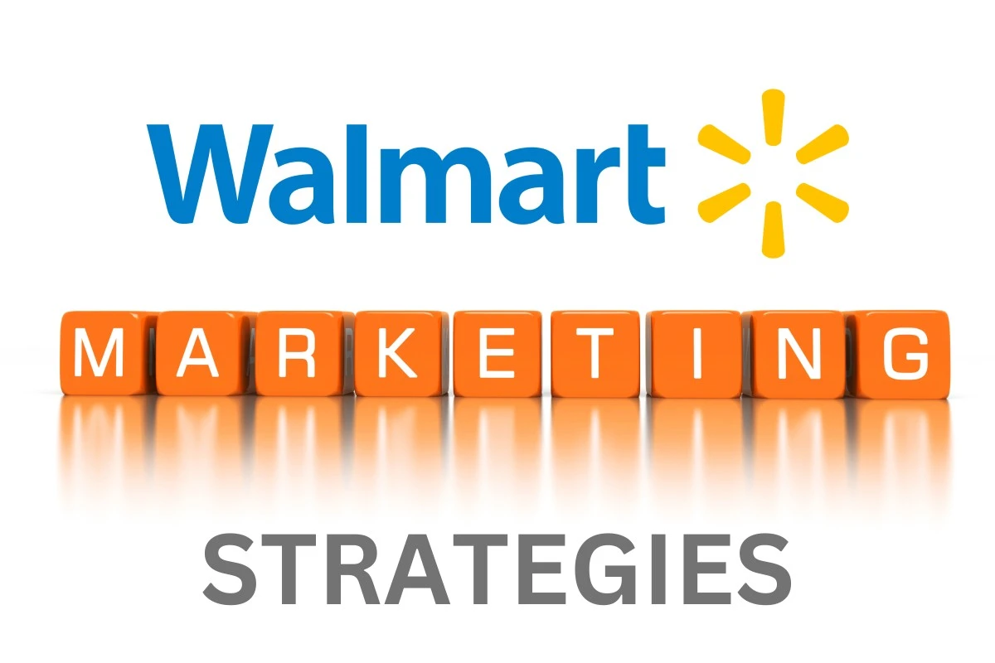
Marketing Strategies
Low Pricing Strategy "Everyday Low Prices" (EDLP) attract budget-conscious consumers.
Walmart’s efficient supply chain management and large-scale operations help maintain competitive pricing.
Price match guarantees enhance customer trust and reinforce its value proposition.
Multichannel Marketing Walmart uses a multichannel approach, reaching customers via TV ads, online advertisements, social media, and in-store promotions.
This strategy ensures high visibility and engagement with a diverse audience, strengthening its brand presence.
E-commerce and Digital Marketing Walmart heavily invests in online platforms like grocery pickup and home delivery for seamless shopping experiences.
Extensive email marketing campaigns promote deals, personalized offers, and seasonal sales.
Adoption of mobile payment systems, drones for delivery, and advanced inventory management streamlines operations and improves customer satisfaction.
4

Slide 12
Marketing Strategies
Customer Loyalty Programs
Programs like Walmart+ (offering free delivery, fuel discounts, exclusive deals) and Savings Catcher encourage repeat purchases.
Designed to retain customers, these programs provide ongoing value and enhance customer loyalty.
Seasonal Promotions and Discounts
Walmart runs heavy promotions during key seasons like Black Friday, Cyber Monday, and Back-to-School.
Offers substantial discounts and combo deals attract customers during peak shopping times.
Omni-Channel Approach
Walmart blends in-store and online shopping experiences with features like Buy Online, Pick Up in Store (BOPIS) and curbside pickups.
This approach offers convenience and flexibility to customers, enhancing their shopping experience.
4

Slide 13
Marketing Strategies
In-Store Promotions and Product Displays
Walmart utilizes "Rollback" discounts and strategic product placements to encourage impulse buying.
These in-store promotions increase sales and visibility for key products, driving customer purchases.
Private Labels and Product Diversity
Walmart’s private-label products, such as Great Value, provide affordable alternatives to national brands.
The wide product range ensures Walmart remains a one-stop shop, catering to various customer needs.
Sustainability and Social Responsibility
Walmart is committed to eco-friendly practices and improving working conditions in its supply chain.
The company supports local causes, participates in sustainability efforts, and engages in philanthropy, appealing to socially conscious consumers.
4

Slide 14
Marketing Strategies
Social Media Marketing
Walmart uses platforms like Facebook, Instagram, and Twitter for targeted advertising and customer engagement.
Collaborates with influencers and runs user-generated content campaigns to improve brand visibility.
Data analytics is used to personalize ads on social media, ensuring relevant content reaches the right audience.
4

Slide 15
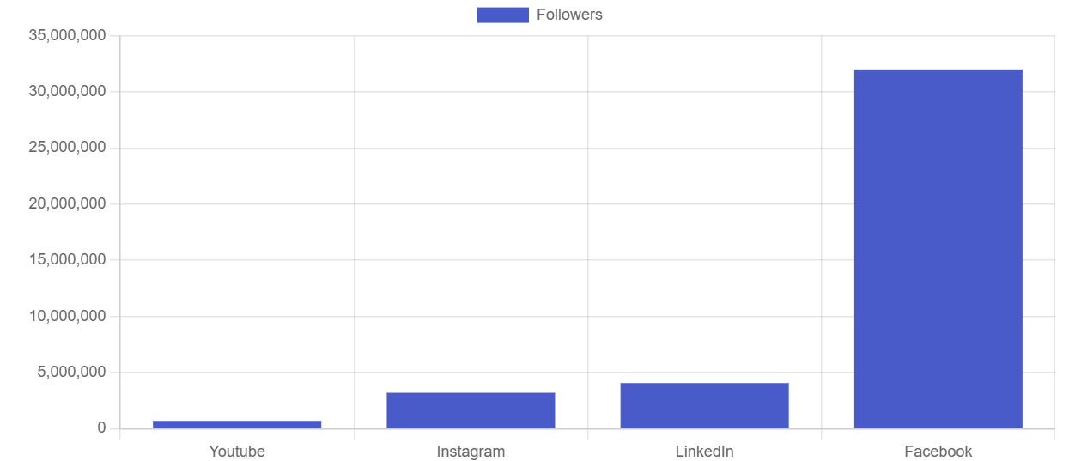
Walmart Social media marketing strategy breakdown

Slide 16
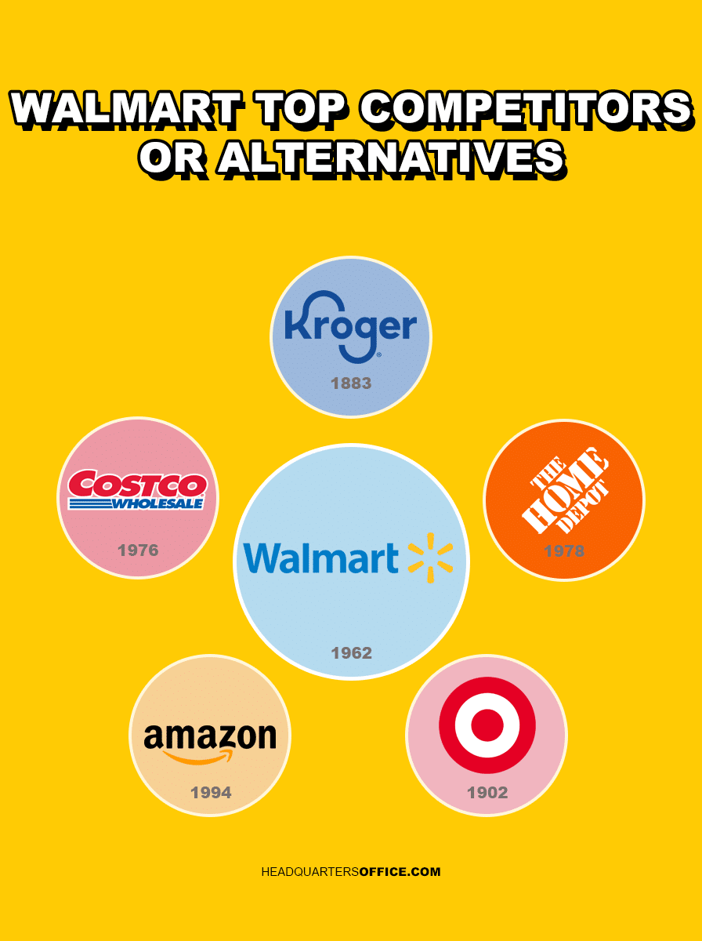
Top 5 Competitors and Their Marketing Strategies
Walmart is a global retail leader, competing in several sectors such as groceries, general merchandise, and e-commerce. Its vast scale allows it to offer low prices, which draws customers. However, several top competitors have their own strengths and marketing strategies, positioning themselves in ways that compete with Walmart on various fronts.
Top five competitors of Walmart:
Amazon
Costco Wholesale Corporation
Target
Kroger
The Home Depot
These competitors challenge Walmart in various sectors like e-commerce, wholesale, grocery retail, and home improvement, using distinct marketing strategies to attract and retain customers.

Slide 17

1. Amazon
Amazon, founded by Jeff Bezos in 1994, is the world’s largest online retailer and a significant competitor to Walmart, particularly in e-commerce. Amazon offers a vast selection of products ranging from electronics to groceries and digital services, and its business model is rooted in convenience, speed, and customer satisfaction.
Marketing Strategy:
Customer Obsession: Amazon focuses on delivering an exceptional customer experience through fast shipping, personalized product recommendations, and a seamless shopping experience.
Prime Membership: The Amazon Prime program enhances customer loyalty with exclusive perks like free shipping, access to movies and music, and exclusive discounts.
Aggressive Pricing: Amazon uses dynamic pricing algorithms and aggressive sales strategies like daily deals to maintain competitive pricing across product categories.
Omni-channel Integration: Amazon leverages its physical stores (Amazon Go, Whole Foods) alongside its e-commerce platform to offer a cohesive shopping experience.

Slide 18
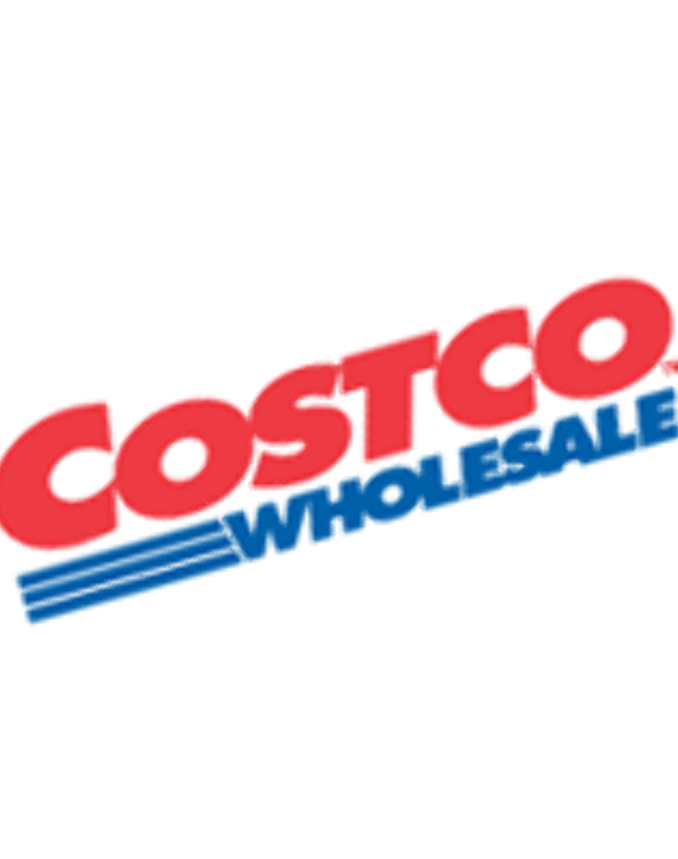
2. Costco
Costco, founded in 1983, is a membership-based warehouse retailer that operates in 11 countries. Known for offering high-quality goods in bulk, Costco provides value through its low pricing model and exclusive membership perks. Costco has built a loyal customer base by offering both branded and private-label products at competitive prices.
Marketing Strategy:
Membership Model: Costco’s business revolves around its membership-based model, offering bulk goods at low prices exclusively to members.
Low-Cost, High-Quality Offerings: Costco focuses on providing high-quality products at wholesale prices, often under its own private label, Kirkland Signature.
Minimal Advertising: The brand relies on word of mouth and its strong reputation to attract and retain customers, with limited traditional advertising.
Exclusive Product Selection: Costco partners with top brands for exclusive deals and offers high-margin items like electronics at competitive prices.
4

Slide 19

3. Target
Target, founded in 1902, is a discount retailer known for its attractive in-store experience and trendy product selection. With a focus on stylish yet affordable products, Target positions itself as a more fashion-forward, customer-centric alternative to Walmart.
Marketing Strategy:
Premium Positioning: Target positions itself as a retailer offering high-quality, stylish products at affordable prices, often targeting middle- to upper-class shoppers.
Loyalty Programs: The Target Circle loyalty program offers discounts, early access to sales, and rewards, building customer loyalty.
Branding and Community Engagement: Target’s marketing emphasizes its commitment to sustainability and inclusivity, often integrating these values into its product offerings.
Omni-channel Strategy: Target's seamless integration of its mobile app, in-store shopping, and services like curbside pickup and same-day delivery enhances convenience for customers.

Slide 20
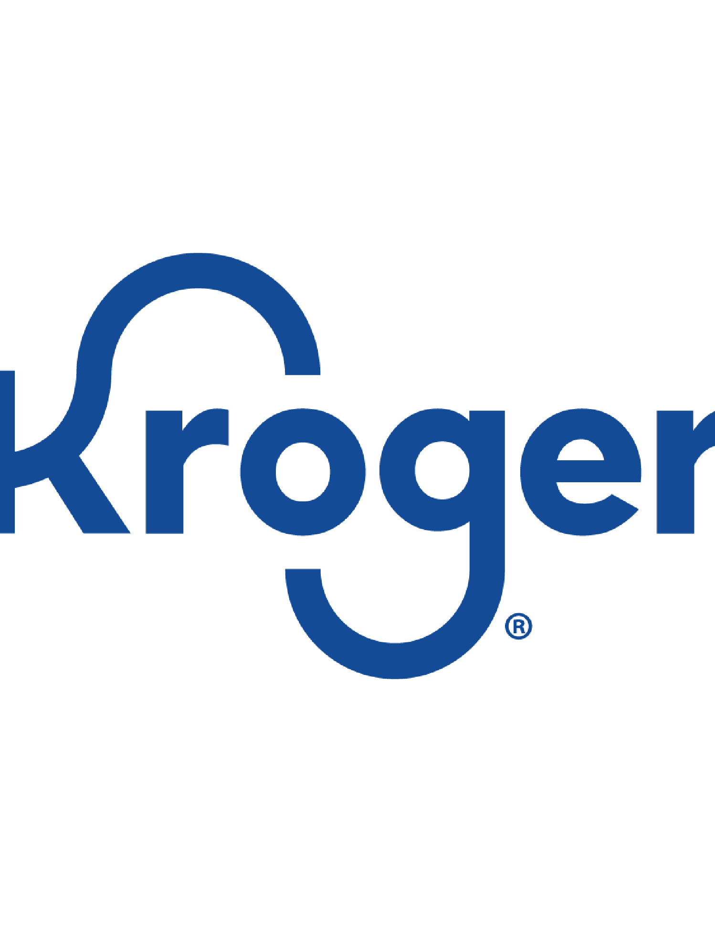
4. Kroger
Kroger, established in 1883, is one of the largest grocery store chains in the U.S. With over 2,700 stores, it dominates the grocery retail space and competes with Walmart in food and beverage sales. Kroger has a strong focus on fresh produce, private label products, and customer loyalty.
Marketing Strategy:
Personalized Discounts: Kroger uses the Kroger Plus loyalty card to deliver personalized discounts based on shopping habits, strengthening customer loyalty.
Regional Customization: Kroger tailors its product offerings to regional preferences and consumer demands, promoting local goods alongside national brands.
Omni-channel Retailing: Kroger integrates online ordering, delivery services, and curbside pickup into its shopping experience, enhancing convenience for customers.
Sustainability and Health Focus: Kroger places significant emphasis on sustainability, health-conscious products, and fresh, organic produce in its marketing efforts.

Slide 21
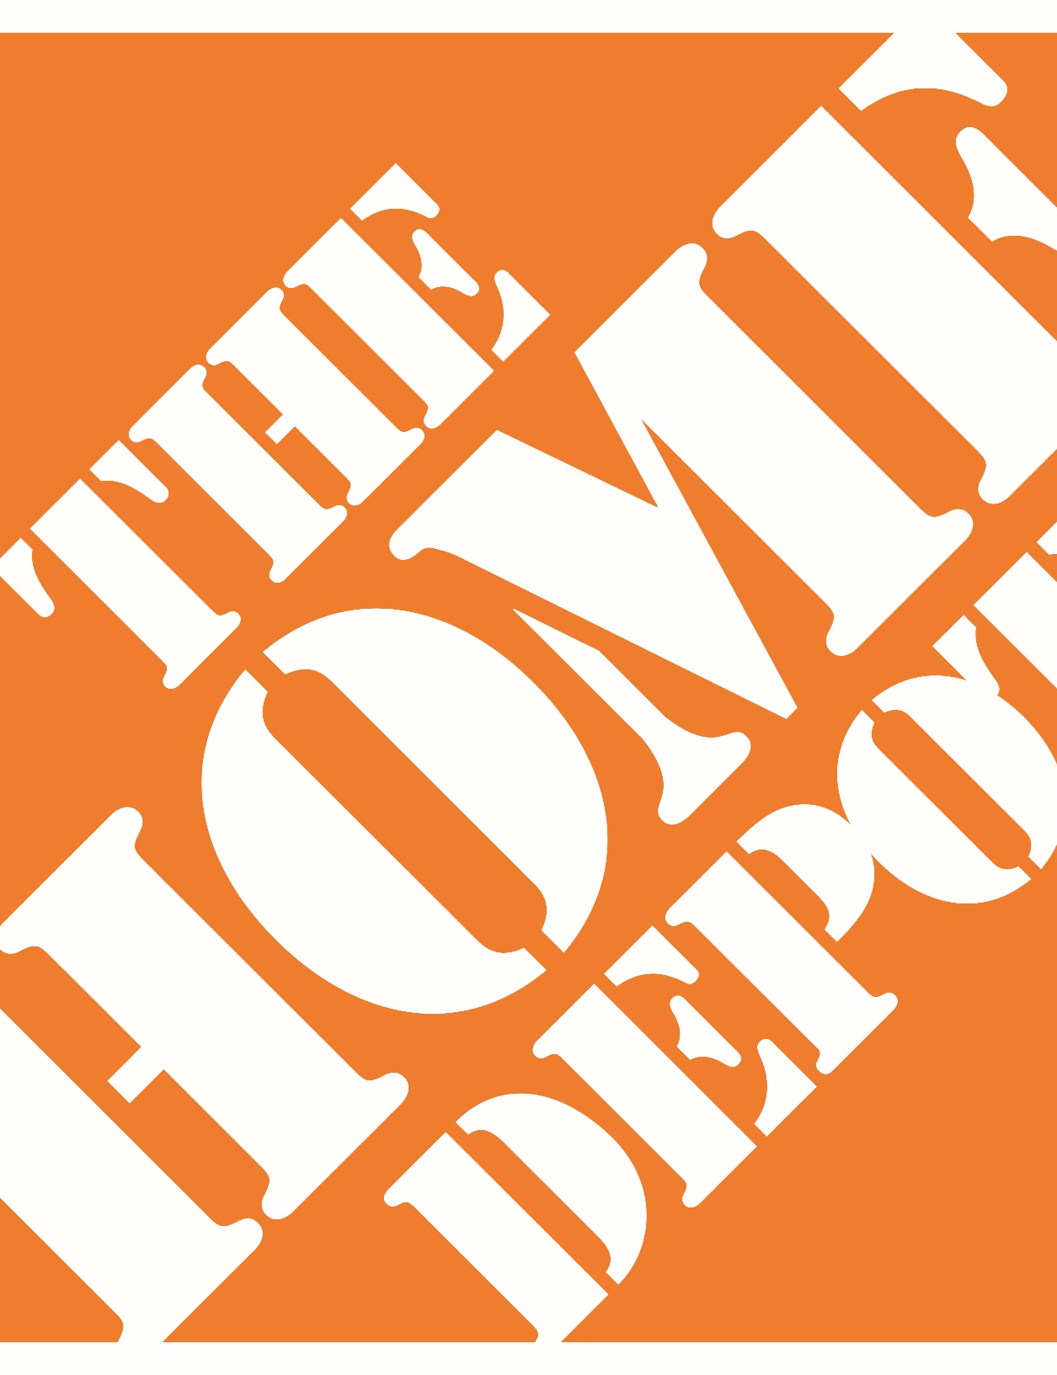
5. The Home Depot
Home Depot, founded in 1978, is the largest home improvement retailer in the U.S. It offers a wide range of building materials, tools, and services for both professional contractors and DIY customers. Home Depot competes with Walmart in categories like home improvement and appliances.
Marketing Strategy:
DIY and Professional Focus: Home Depot caters to both DIY customers and professional contractors, offering products and services tailored to these groups.
Educational Content: The company invests heavily in educating its customers through how-to videos, project guides, and in-store expert advice, positioning itself as a trusted resource.
Click-and-Collect and Delivery: Home Depot integrates its digital services with physical locations, offering online order pickup, and in-store delivery services to enhance the customer experience.
Pro Xtra Loyalty Program: Home Depot’s Pro Xtra program is designed for professional contractors, offering personalized discounts, rewards, and project management tools.
4

Slide 22
Summary of Competitors’ Marketing Strategies
Competitor | Core Strategy | Key Tactics
Amazon | Customer obsession, technology-driven, convenience | Prime membership, dynamic pricing, AI & data use
Costco | Membership-based, bulk pricing, high value | Limited advertising, high-quality private label
Target | Affordable style, community-focused, premium branding | Loyalty programs, exclusive designer collabs
Kroger | Personalized discounts, regional focus | Loyalty cards, omni-channel integration
Home Depot | DIY and Pro-focused, expert advice, project-driven | Click-and-collect, in-store educational content
6

Slide 23
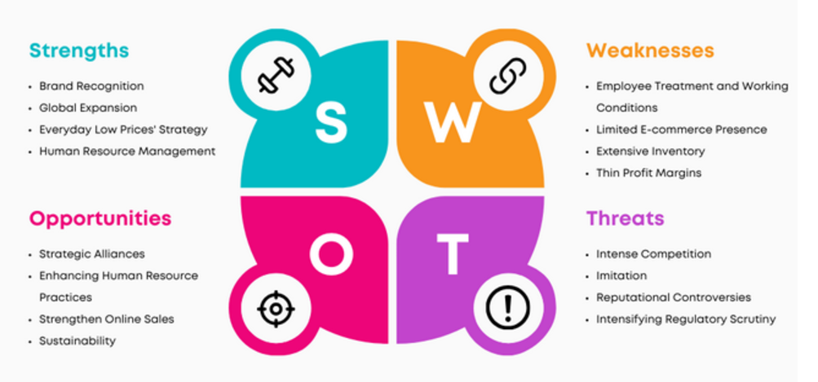
SWOT Analysis of Walmart
5

Slide 24
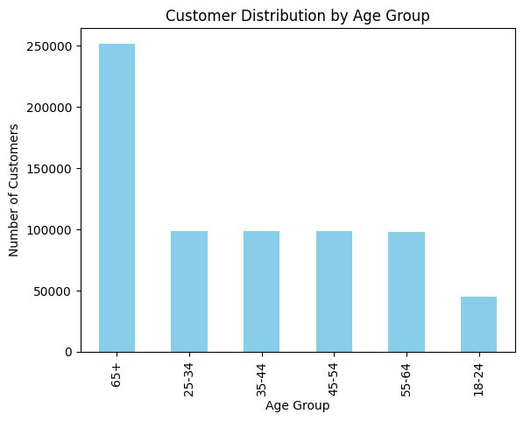
Plot 1 : Customer Distribution by Age group
Insights:
65+ (Seniors): The largest group, indicating a growing market for products focused on health and leisure due to retirement and fixed incomes.
18-24 (Gen Z): The smallest group, likely due to limited spending power as many are students or early career, with a focus on affordability and tech.
25-34 (Millennials), 35-44 (Older Millennials & Gen X), 45-54 (Gen X), 55-64 (Baby Boomers): All have similar customer count, suggesting a balanced market. These groups represent a mix of high spending potential, family stability, health focus, and premium product interest.
Recommendation:
Seniors (65+): Focus on health, leisure, and retirement planning products.
Gen Z (18-24): Cater to affordable, tech-driven products with a focus on value.
Millennials, Older Millennials & Gen X, Gen X, and Baby Boomers: Offer a mix of family-oriented, health-conscious, premium, and leisure-focused products, ensuring balance in product offerings across these similar-sized segments.
4

Slide 25
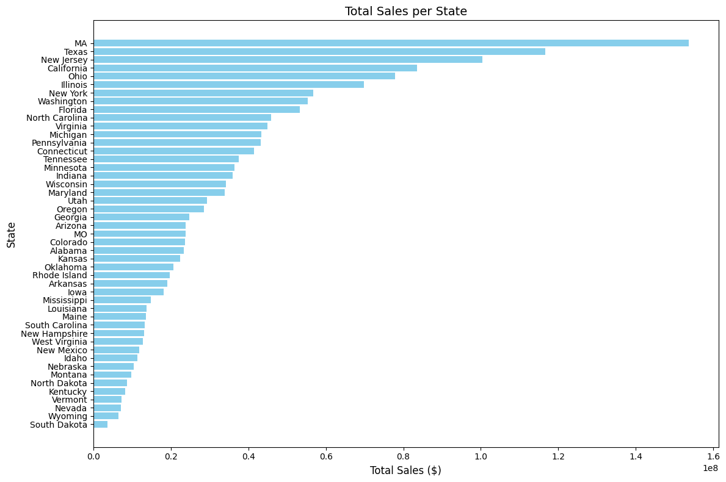
Plot 2 : Total sales per state
Insights:
Massachusetts (MA) has the highest total sales, followed by Texas and New Jersey, indicating strong market performance in these states.
South Dakota has the lowest total sales, suggesting limited market activity or a smaller customer base.
Recommendation:
Focus on high-performing states like Massachusetts, Texas, and New Jersey for targeted marketing and inventory optimization.
Investigate low-sales states like South Dakota to understand potential barriers and explore opportunities to increase market share, such as localized promotions or product offerings tailored to regional preferences.
4

Slide 26
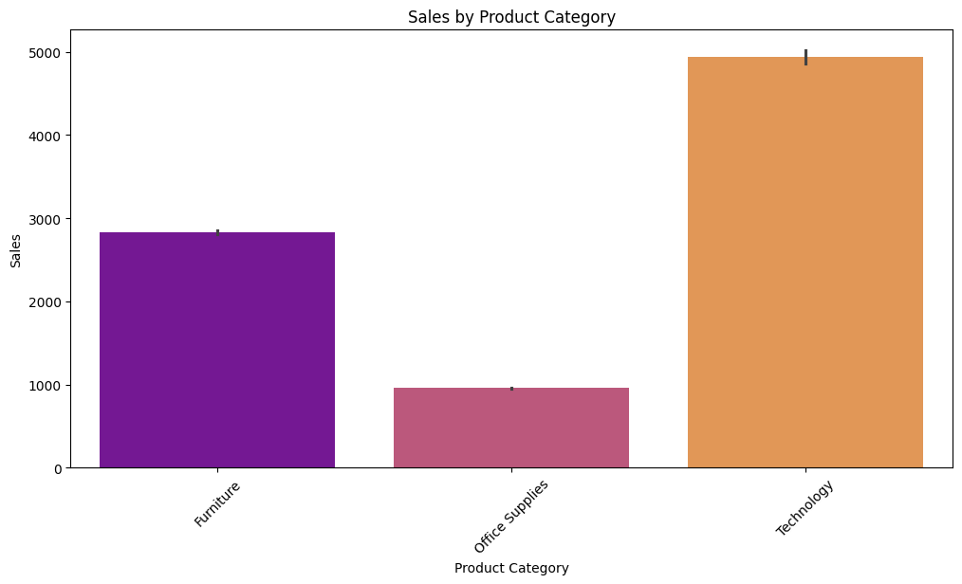
Plot 3: Sales by Product category
Insights:
Technology dominates with the highest sales showing it is a top-performing category.
Furniture follows with solid sales indicating strong but not dominant performance.
Office Supplies has significantly lower sales suggesting it is underperforming compared to the other categories.
Recommendation:
Focus on Technology: Given its strong performance, Walmart should prioritize stock levels, promotions, and advertising for Technology products to capitalize on this demand.
Optimize Furniture Sales: While Furniture sales are good, there is potential for growth. Consider targeted campaigns or bundling to increase sales.
Reevaluate Office Supplies: Since this category lags behind, Walmart should assess pricing, product assortment, or marketing strategies to drive sales in this segment. Consider promotional activities or introducing new products to spark customer interest.
4

Slide 27
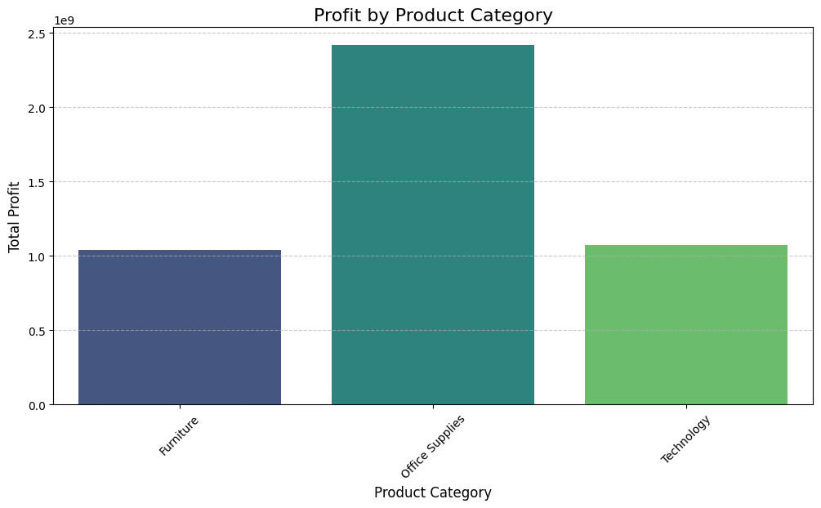
Plot 4: Profit by Product category
Insights:
Office Supplies Lead: Office Supplies generate the highest profits.
Furniture shows moderate profits.
Technology has lower profits.
Recommendations:
Boost Furniture & Technology: Invest in marketing and optimize pricing.
Leverage Office Supplies: Expand offerings and promotions to capitalize on its profitability.
Improve Supply Chain: Reduce costs for underperforming categories.
4

Slide 28
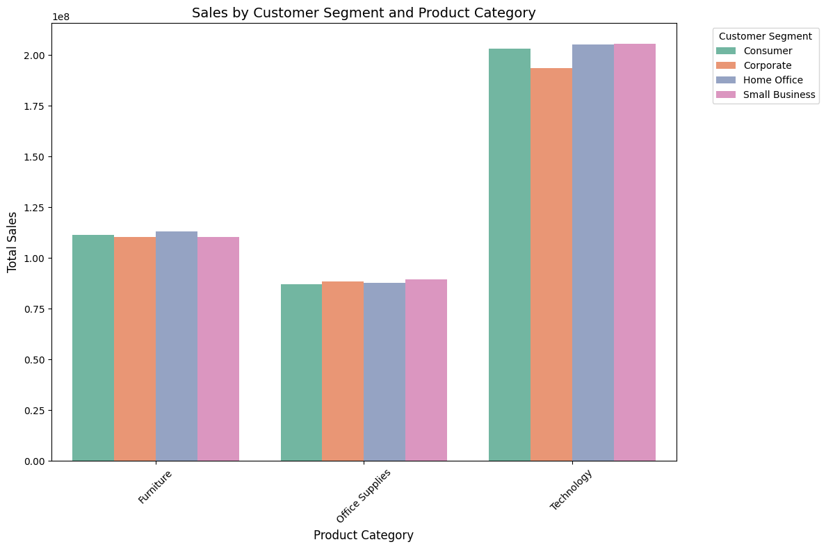
Plot 5: Sales by Customer Segment & Product category
Insights:
Technology Leads Sales: The Technology category consistently shows the highest sales across all segments, demonstrating strong and uniform demand.
Moderate Demand for Furniture and Office Supplies: Sales for Furniture are slightly higher than Office Supplies across all segments, but both categories lag significantly behind Technology.
Uniform Sales Patterns: Customer segments display similar sales patterns across all categories, with no major deviations.
Recommendations:
Focus on Technology: Prioritize inventory and marketing efforts on Technology, introducing premium bundles or exclusive offers.
Boost Furniture and Office Supplies: Launch targeted campaigns.
Drive Cross-Sales: Bundle Technology items with Furniture or Office Supplies to encourage cross-category purchases.
Optimize Inventory: Ensure sufficient stock of high-demand Technology items while maintaining steady supply for other categories.
4

Slide 29
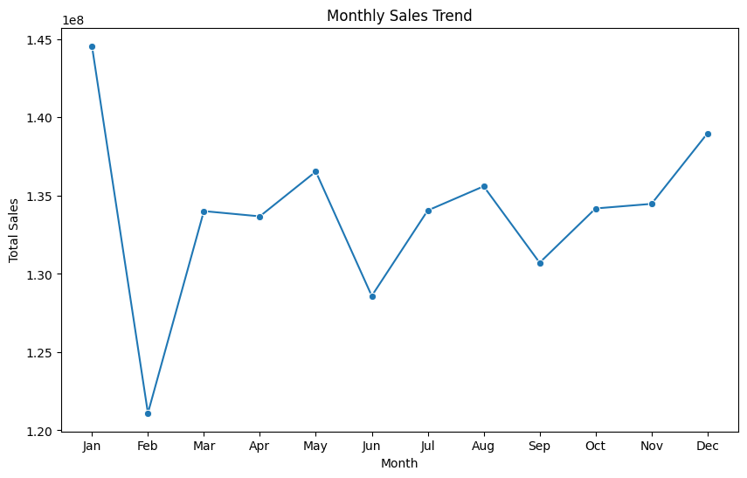
Plot 6: Monthly sales trend
Insights:
Seasonal Peaks: High sales in January and December, likely due to holidays and promotions.
Sales Dips: Significant drop in February and low sales in June and September.
Year-End Growth: Strong upward trend in November and December indicates effective holiday demand.
Recommendations:
Promotions: Focus discounts and campaigns in February, June, and September to boost sales.
Inventory: Stock up for January, November, and December, reduce inventory during low months.
Targeted Ads: Align campaigns with key shopping seasons like back-to-school and holidays.
Analyze Dips: Investigate reasons behind February and mid-year declines for corrective actions.
4

Slide 30
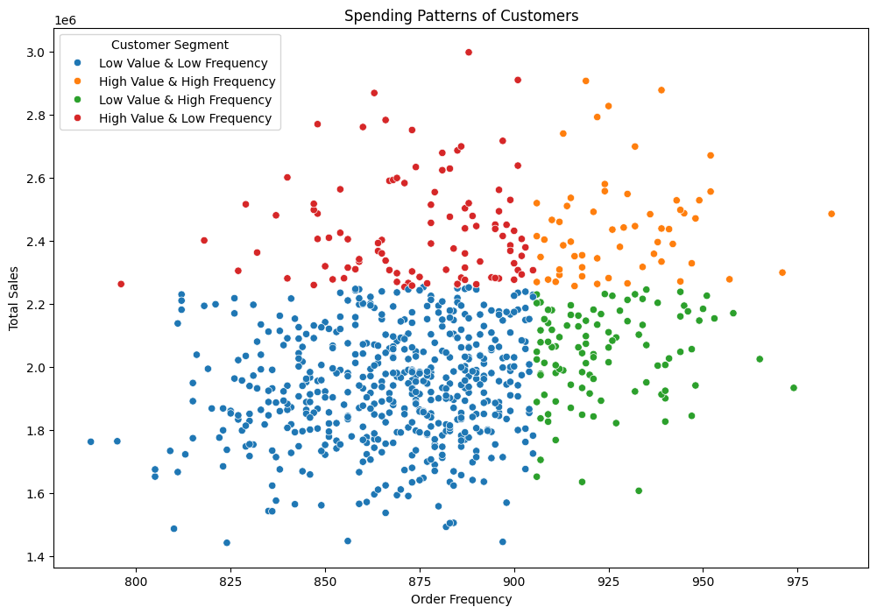
Plot 7: Customer segmentation based on spending patterns of customers
Insights:
Blue (Low Value & Low Frequency): Low sales and infrequent orders. Risk of churn.
Orange (High Value & High Frequency): High sales and frequent orders. Ideal, loyal customers.
Red (High Value & Low Frequency): High sales but infrequent purchases. Potential for more engagement.
Green (Low Value & High Frequency): Frequent orders, but low total sales. Potential to increase order value.
Recommendations:
Blue: Engage with promotions to boost frequency and sales.
Orange: Retain through loyalty programs and exclusive offers.
Red: Encourage repeat purchases with timely reminders and incentives.
Green: Increase average order value with product bundles or discounts.
4

Slide 31
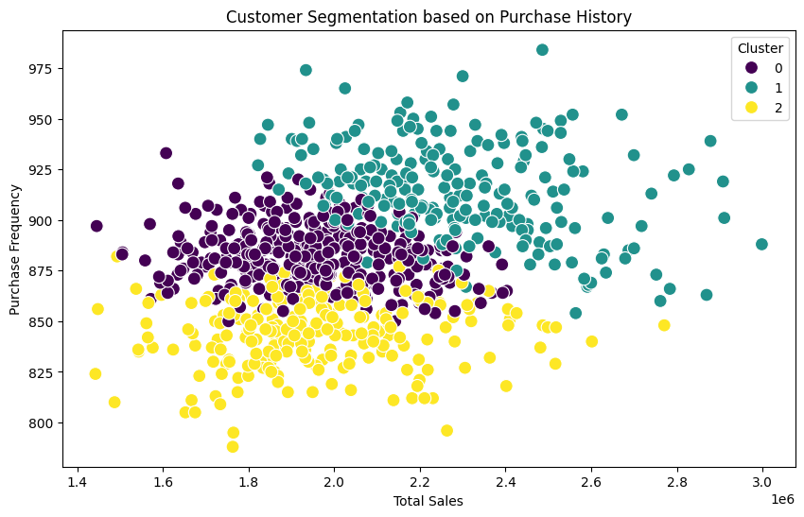
Plot 8:Customer segmentation based on Purchase history
Insights:
Cluster 0:Customers in this cluster have moderate sales and purchase frequency.
Cluster 1:These customers are the highest contributors in both sales and purchase frequency, showing high engagement.
Cluster 2:These customers contribute a similar sales value to Cluster 0 but purchase less frequently.
Recommendations:
Cluster 0:Implement loyalty programs and targeted promotions to encourage repeat purchases and increase sales.
Cluster 1:Utilize personalized rewards, exclusive offers, and cross-selling to maximize sales and keep these high-value customers engaged.
Cluster 2:Target Cluster 2 with personalized promotions, loyalty rewards, and re-engagement strategies to boost purchase frequency and increase overall sales.
4

Slide 32
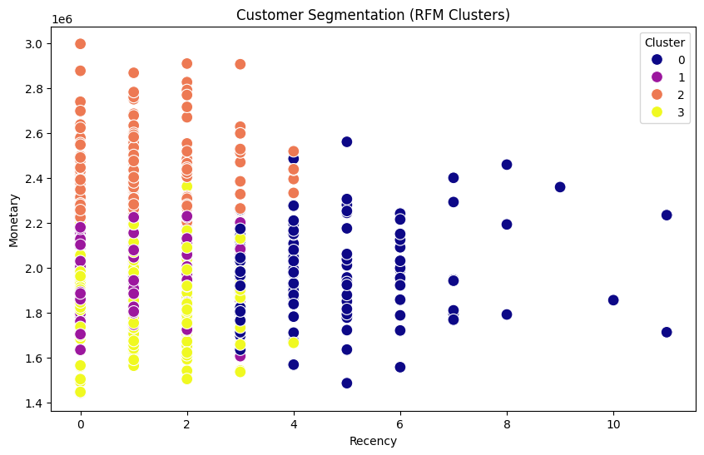
Plot 8:Customer segmentation based on Purchase history
Insights:
Cluster 0:Customers are somewhat active with a moderate amount of sales. They have the highest mean recency, indicating they made purchases recently.
Cluster 1 : Customers have a very recent recency and high frequency of purchases, contributing the second-highest monetary value.
Cluster 2 : It represents the highest monetary value, though the frequency is slightly lower than Cluster 1. They are highly engaged and have a very recent purchase behavior.
Cluster 3: It is slightly less active than other clusters in terms of frequency and sales but still contributes moderately in both.
Recommendations:
Cluster 0: Re-engage with personalized offers, reminders, and loyalty rewards.
Cluster 1: Strengthen loyalty with exclusive deals, VIP perks, and tailored recommendations.
Cluster 2: Retain high-value customers with premium services, upselling, and referral incentives.
Cluster 3: Boost purchase frequency with targeted promotions, discounts, and repurchase reminders.
4

Slide 33
Recommendations
Improve targeting strategies to increase engagement across all customer age groups.
Strengthen marketing efforts around the most profitable product categories.
Optimize product pricing and promotions to improve overall profit margins.
Leverage seasonal trends to plan targeted campaigns and promotions.
Increase customer retention through personalized and value-driven loyalty programs.
Use geographic insights to tailor regional marketing and optimize distribution strategies.
Monitor customer buying frequency to create more opportunities for repeat sales.
Streamline inventory management and shipping costs to maximize profitability.

Slide 34

References
Walmart – Wikipedia
https://panmore.com/walmart-vision-mission-statement-intensive-generic-strategies
Walmart Marketing Strategy (2024)
https://businesschronicler.com/competitors/walmart-competitors-analysis/#walmart-competitor-analysis-faqs
https://www.marketing91.com/swot-walmart/
https://www.gliesess.com/marketing-strategy/walmart
Marketing Strategies, Marketing Mix and STP of Walmart

Slide 35

THANK YOU

